Slide 1
Git Branch Tutorial
January 23, 2025
Real-Time Operating Systems Laboratory,
Department of Electrical and Computer Engineering,
Seoul National University

Slide 2
Contents
Git Branch Tutorial
Introduction to Branch in Git
Basics of Git Branch
Basics of Git Merge
Assignments

Slide 3
Collaboration with Git (1)
I. Introduction to Branch in Git
Commit histories are not always linear
Divergence occurs when different team members work on separate tasks during collaboration
The merge process is needed to gather these branches and create a new version
Notes:
그래서 소피는 이 컨테이너 기술을 자동차에

Slide 4
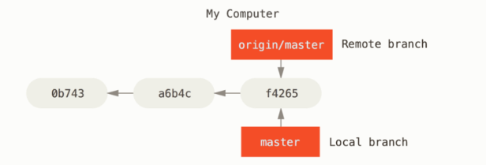
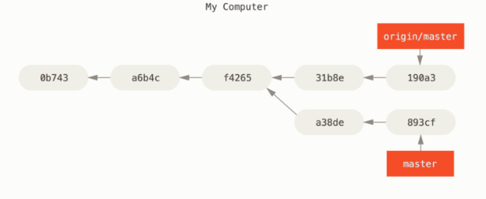
Collaboration with Git (2)
I. Introduction to Branch in Git
Notes:
그래서 소피는 이 컨테이너 기술을 자동차에

Slide 5
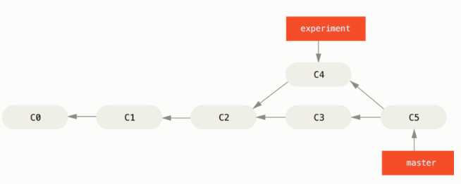
Collaboration with Git (3)
I. Introduction to Branch in Git
Notes:
그래서 소피는 이 컨테이너 기술을 자동차에

Slide 6
Branches
I. Introduction to Branch in Git
Definition
Independent work of development for making changes or adding features without interfering with other ongoing work
Internally, a movable pointer to a specific commit
Features
Supports concurrent development by allowing teams to work on separate features without conflicts
Facilitates integration of divergent code through merging, enabling teams to combine their work when ready
Notes:
그래서 소피는 이 컨테이너 기술을 자동차에

Slide 7
Git Branch (1)
II. Basic of Git Branch
Demonstration
브랜치의 사용법 (1, 2) - 생활코딩https://opentutorials.org/course/3840/23677
Notes:
그래서 소피는 이 컨테이너 기술을 자동차에

Slide 8
Git Branch (2)
II. Basic of Git Branch
Commands for git branch
List, create or delete branches: git branch [--options] [<branch-name>]
List
Only local branches
git branch
Including remote branches
git branch –a
Create
git branch feature1
Delete
git branch –d feature1
Rename
git branch –m feature2

Slide 9
Git Branch (3)
II. Basic of Git Branch
Commands for git branch
Switching to different branches: git switch [--options] [<branch-name>]
To switch branches
git switch feature1
To create and switch to a new branch
git switch –c feature1

Slide 10
Git Merge (1)
III. Basic of Git Merge
Demonstration
브랜치 병합 (1, 2, 3) - 생활코딩https://opentutorials.org/course/3840/23682
Notes:
그래서 소피는 이 컨테이너 기술을 자동차에

Slide 11
Git Merge (2)
III. Basic of Git Merge
Commands for git merge
Commands used for merging: git merge [<branch-name>]
To merge feature2 into the current branch
git merge feature2
To merge feature2 into feature1
git merge feature1 feature2
Notes:
그래서 소피는 이 컨테이너 기술을 자동차에

Slide 12
Git Merge (3)
III. Basic of Git Merge
Commands for git merge
Commands used for resolving conflicts: git merge (--continue | --abort)
To complete the merge after resolving conflicts manually git merge –-continue
To abort the merge process
git merge --abort
Notes:
그래서 소피는 이 컨테이너 기술을 자동차에

Slide 13
Assignments
IV. Assignments
Practice git branch commands
git branch, git switch, git merge
Make branches and collaborate with colleagues
https://github.com/SNU-RTOS/cloud-native-study?tab=readme-ov-file#%EC%8B%A4%EC%8A%B5-%EA%B3%BC%EC%A0%9C

